Slide 1
Diabetic Retinopathy Detection using Deep Learning
S.No | Roll No | Name | Project Guide
1 | 160118733130 | Jyoshna Kandi | Dr. B. Bhargavi
2 | 160118733131 | Lahari Madishetty | Dr. B. Bhargavi
Batch Id : 09

Slide 2
OUTLINE
Abstract
Introduction
Problem Description
Existing System
Proposed System
Methodology
Dataset Description
Design Diagrams
Result Analysis
Conclusion
Future Scope
References

Slide 3
ABSTRACT
Diabetic Retinopathy (DR) is a human eye disease that affects people who have diabetes and damages their retina, potentially leading to blindness. DR has been manually screened by an ophthalmologist until recently, which is a time-consuming technique.
The goal is to use technology to scale their efforts and achieve the ability to automatically screen photographs for disease and provide information on the severity of the issue. This automation technique can save a lot of time, which can be used to screen the process of treating diabetic retinopathy on a wide scale. As a result, this project will focus on the analysis of various DR stages using Deep Learning (DL).
We will train a neural network model using a large dataset of 3662 train photos to automatically recognize the DR stage, which will be categorized into high-resolution fundus images in this project. There are five different DR stages: 0, 1, 2, 3, and 4. The input parameters for this project are the patient's fundus eye photographs. The features of fundus images of the eye will be extracted by a trained model, and the activation function will provide the output.
The CNN model is constructed using an ensemble of ResNet (residual neural network) and Xception architecture, and after training, the model has an accuracy of 0.72. The trained model is then put to the test on a variety of retinal pictures to determine the DR diagnosis level.

Slide 4
INTRODUCTION
Diabetic Retinopathy (DR) is human eye illness which occurs in individuals who have diabetics which harms their retina and in the long run, may lead visual deficiency.It is the most debilitating form of diabetes in which serious damage occurs to the retina and causes visual impairments.
It harms the veins inside the retinal tissue, making them spill fluid and contort vision.
There are five stages of DR that is 0, 1, 2, 3, and 4. Each stages has its own symptoms and specific properties.
No DR (class 0)
Mild DR (class 1)
Moderate DR (class 2)
Severe DR (class 3)
PDR (Proliferative DR) (class 4)

Slide 5
PROBLEM DESCRIPTION
Diabetic retinopathy (DR) is one of the most serious complications of diabetes, causing damage to the retina and eventually blindness. The ability to automatically detect diabetic retinopathy in photographs and provide information on the severity of the condition. This will be accomplished by developing a convolutional neural network model that can automatically analyze a patient's ocular picture and determine the severity of blindness. This automation technique can save a lot of time. This can be used to monitor the progress of diabetic retinopathy treatment on a large scale.
The importance of this project is that it assists doctors in initiating diabetic retinopathy treatment at the appropriate time and in diagnosing the disease in its early stages. The main objective of this project is to create a Convolutional Neural Network model that will help us recognize and classify the stage of Diabetic Retinopathy that a patient is experiencing, as well as the severity of the condition.

Slide 6
EXISTING SYSTEM
The existing methods for diagnosing are very inefficient because it takes very large time, due to which the treatment may go the wrong way.
To detect retinopathy doctors used fundus camera which takes the picture of veins and nerves which is behind the retina.
The initial phase of this disease has no signs of DR, so it turns into a real challenge to recognize it into a starting stage.

Slide 7
PROPOSED SYSTEM
The goal here is to gain the ability to automatically screen images for disease and provide information on how severe the condition may be.
We shall be achieving this by building a Convolutional neural network model that can automatically look at a patient’s eye image and estimate the severity of blindness in the patient.
This process of automation can reduce a lot of time thereby screening the process of treating diabetic retinopathy at a large scale.

Slide 8
METHODOLOGY
As we know that DR detection problem is a primary cause of blindness. To overcome from this problem early detection is the first concern.
As a result we are using the ensemble of deep learning models, ResNet and Xception, for early detection.
The framework of deep learning for Diabetic Retinopathy Detection includes:
Data Preprocessing
Data Augmentation
Building the CNN model
Training process
Testing process
Medical report

Slide 9
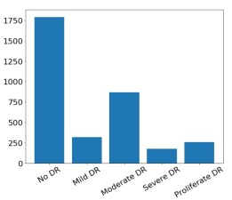
DATASET DESCRIPTION
We will be using the dataset which is publicly available on kaggle i.e.,APTOS 2019 Blindness Detection (APTOS2019) dataset.
The full dataset consists of fundus photographs, which are divided into 3662 training, 1928 testing images.

Slide 10
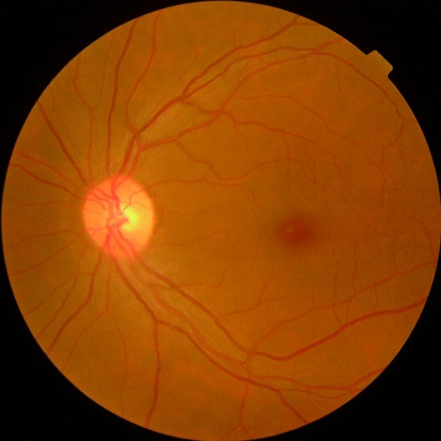
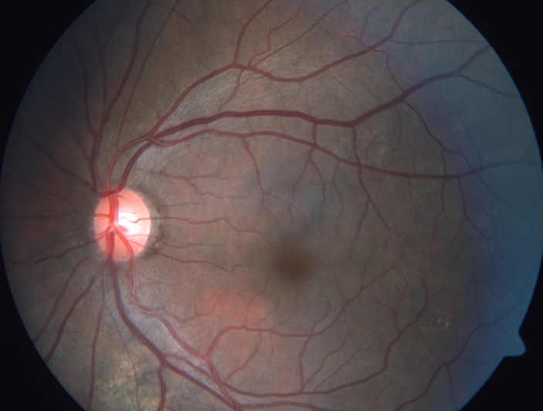
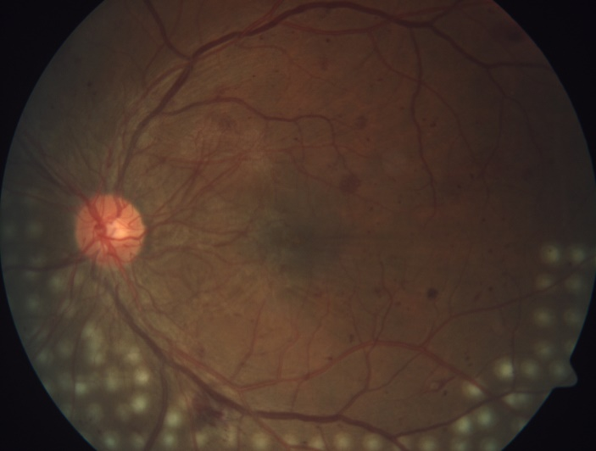
Fundus image :
The fundus, or back of the eye, is photographed in fundus photography. Fundus photography is done with fundus cameras, which combine an intricate microscope with a flash-enabled camera. The central and peripheral retina, optic disc, and macula are the primary components visible on a fundus shot. Colored filters or specific dyes like fluorescein and indocyanine green can be used to photograph the fundus.
Sample Images of Dataset :

Slide 11
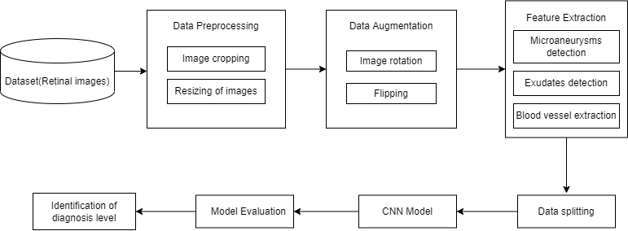
Block Diagram

Slide 12
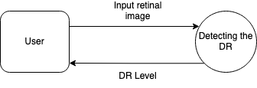
Data flow Diagram (Level-0)

Slide 13
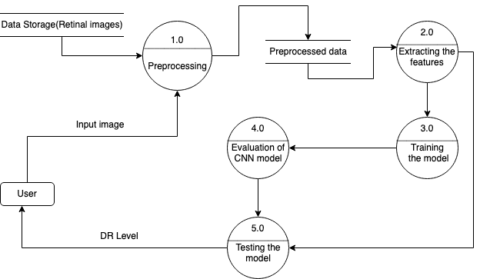
Data flow Diagram (Level-1)

Slide 14
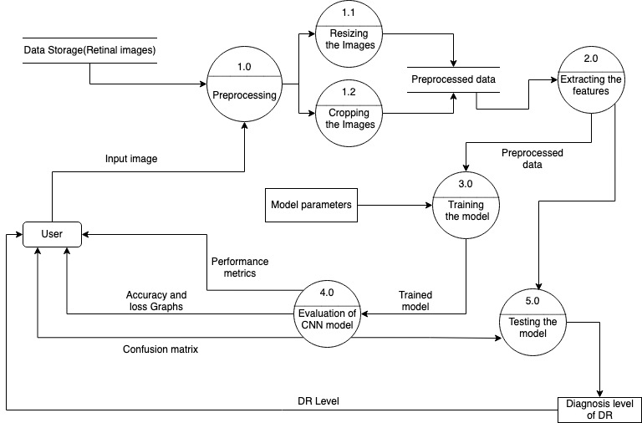
Data flow Diagram (Level-2)

Slide 15
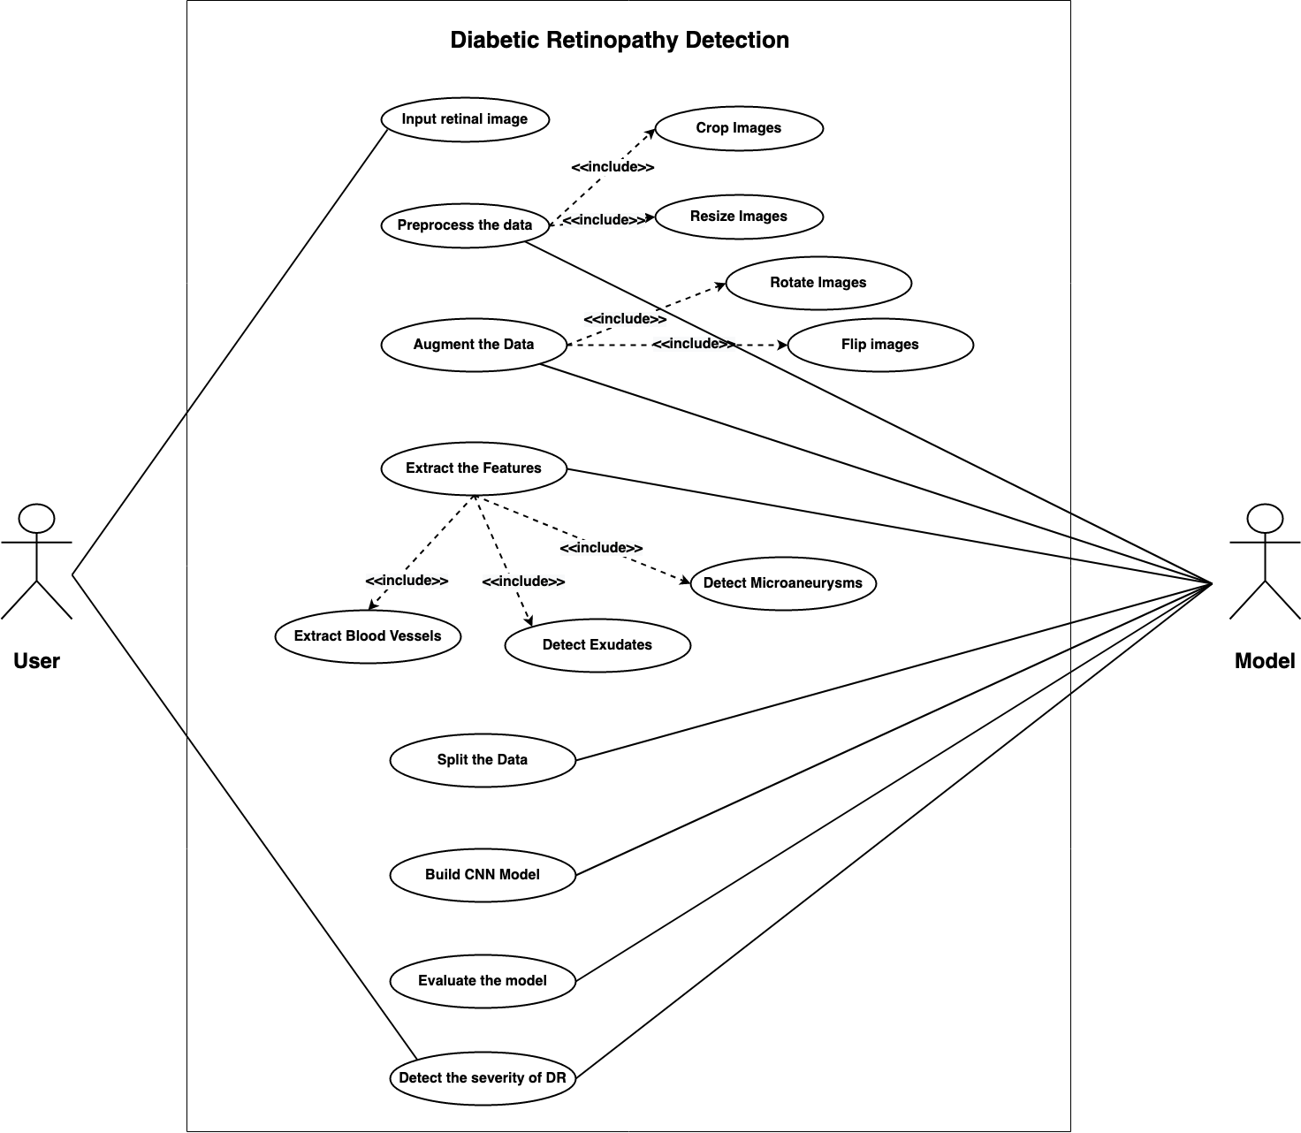
Use Case Diagram

Slide 16
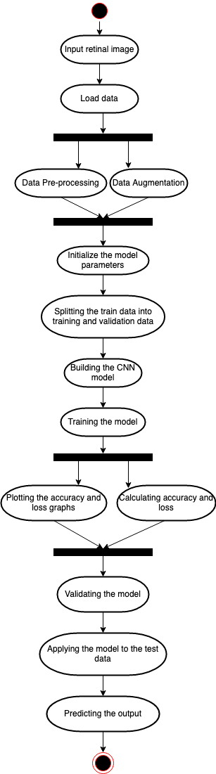
Activity Diagram

Slide 17
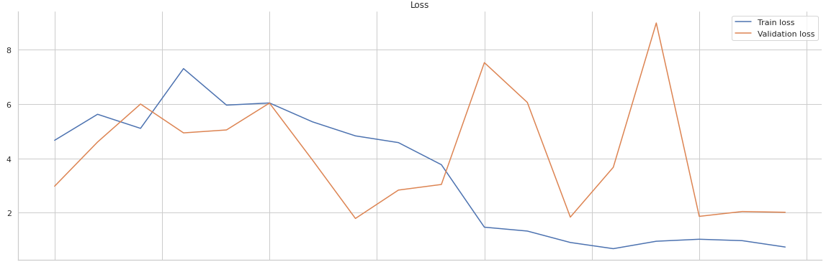
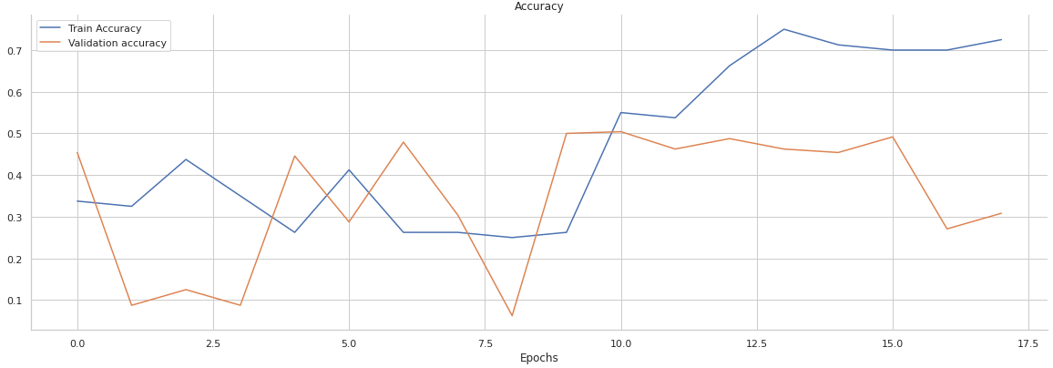
RESULT ANALYSIS
The accuracy and loss graphs
Using ResNet :
Figure 1 : Graphs of Train and Validation Loss (using ResNet) Figure 2 : Graphs of Train and Validation Accuracy (using ResNet)

Slide 18
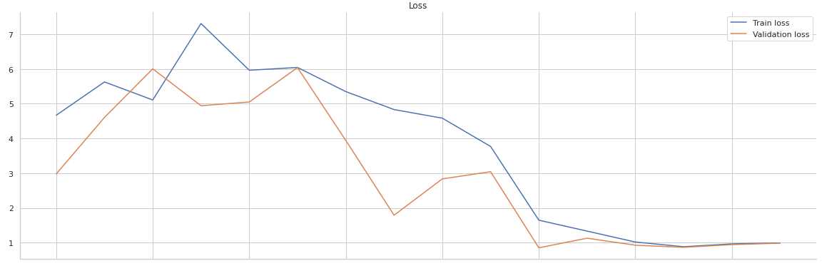
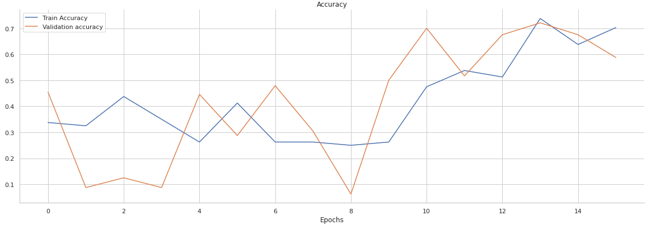
The accuracy and loss graphs
Ensemble of ResNet and VGG:
Figure 3 : Graphs of Train and Validation Loss Figure 4 : Graphs of Train and Validation Accuracy
(Ensemble of ResNet and VGG) (Ensemble of ResNet and VGG)

Slide 19
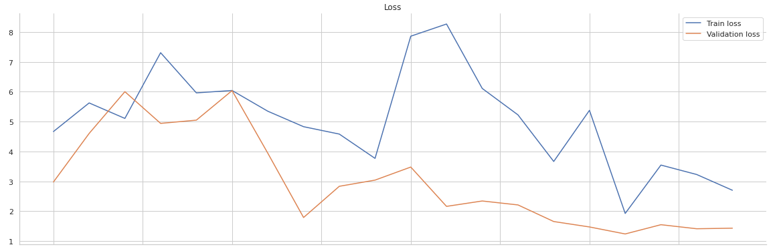
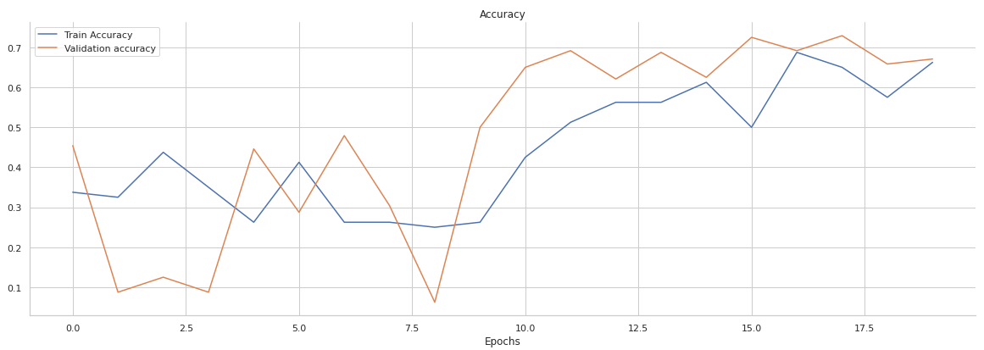
The accuracy and loss graphs
Ensemble of ResNet and Xception:
Figure 5 : Graphs of Train and Validation Loss Figure 6 : Graphs of Train and Validation Accuracy
(Ensemble of ResNet and Xception) (Ensemble of ResNet and Xception)

Slide 20
Analysis of the accuracy and loss graphs of three models
We can see, from the three models i.e., Resnet, ensemble of Resnet and VGG and the other ensemble of Resnet and Xception the accuracies gradually got increasing and the losses got decreased.
For the first model which is Resnet (Refer Figure 1 and Figure 2) the validation loss is greater than the train loss and the validation accuracy is less than the train accuracy.
For the second model which is an ensemble of Resnet and VGG (Refer Figure 3 and Figure 4) we observe that the train and validation loss are gradually decreasing and they have the similar value of losses, when coming to accuracies the train accuracy is increasing gradually and the validation accuracy is getting decreased at a point of time where the train accuracy is more than the validation accuracy. The train and validation losses are gradually decreasing, and the validation loss is less than the train loss.
In the third model, which is an ensemble of Resnet and Xception (Refer Figure 5 and Figure 6) we observe that the train and validation accuracies are increasing, and the validation accuracy is greater than the train accuracy.

Slide 21
Table 1: Results of the architectures
Architecture | Dataset | Accuracy | Precision | Recall | F1 Score
Resnet | Kaggle | 0.49 | 0.24 | 0.49 | 0.33
Ensemble(Resnet, VGG) | Kaggle | 0.66 | 0.52 | 0.66 | 0.58
Ensemble(Resnet, Xception) | Kaggle | 0.72 | 0.69 | 0.72 | 0.67
Table 1 represents the comparison of performance metrics of all the three models when implemented on the same dataset. Here the metrics include values of Accuracy, Precision, Recall, F1 Score.

Slide 22
CONCLUSION
Our project's purpose is to use Fundus Photographs to estimate the severity of Diabetic Retinopathy using a CNN model. It is a truth that the more precise the treatment plan is, the better and more accurate the diagnosis is. As a result, for an effective treatment regimen, diagnostic measures should aim for precision.
We have proposed an approach of ensembling ResNet and Xception architectures for diabetic retinopathy detection. In comparison to other ways, our proposed method performed well which has resulted in an increase in train and validation accuracies and a decrease in train and validation losses. We were able to get a high level of accuracy in the diagnosis outcomes in our project.

Slide 23
FUTURE SCOPE
One can train the model using a large number of images if there is an availability of high computational devices like GPU.
There is also a chance to explore various large-size datasets of Diabetic Retinopathy and increase the accuracy of the model.
One can also make the model more accurate by increasing the number of epochs while training the model if there is an availability of GPU.
The proposed model is not compatible with mobile-like devices. For making the model more compatible with all other devices we could use lightweight models like MobileNet.

Slide 24
REFERENCES
[1]. Supriya Mishra, Seema Hanchate, Zia Saquib; “Diabetic Retinopathy Detection using Deep Learning”; International Conference on Smart Technologies in Computing, Electrical, and Electronics (ICSTCEE 2020); December 19, 2020.
[2]. Emma Beede, Elizabeth Baylor, Fred Hersch, Lauren Wilcox, “A Human-Centered Evaluation of a Deep Learning System Deployed in Clinics for the Detection of Diabetic Retinopathy”, CHI 2020, April 25–30, 2020, Honolulu, HI, USA, 2020.
[3]. Anuj Jain, Arnav Jalui, Jahanvi Jasani, Yash Lahoti, Ruhina Karani. "Deep Learning for Detection and Severity Classification of Diabetic Retinopathy", 2019 1st International Conference on Innovations in Information and Communication Technology (ICIICT), 2019
[4]. Lam C, Yi D, Guo M, Lindsey T., “Automated Detection of Diabetic Retinopathy using Deep Learning,” AMIA Jt Summits Transl Sci Proc. 2018 May 18;2017:147-155. PMID: 29888061; PMCID: PMC5961805.
[5]. Borys Tymchenko , Philip Marchenko and Dmitry Spodarets, “Deep Learning Approach to Diabetic Retinopathy Detection”; March 3,2020. https://arxiv.org/pdf/2003.02261.pdf

Slide 25
THANK YOU

